Slide 1


Getting Started – Hello world
Build a basic with

Slide 2

Get the tools
Download and install Visual Studio
We will do everything in Windows with Visual Studio 2022
you can use different development environment and OS
You can do basic installation
we will only do C++ coding for audio plugins and applications for now
Download JUCE from https://juce.com/download/
Unpack JUCE folder
Put it in some location on your computer
I put it in C:/Program Files

Slide 3
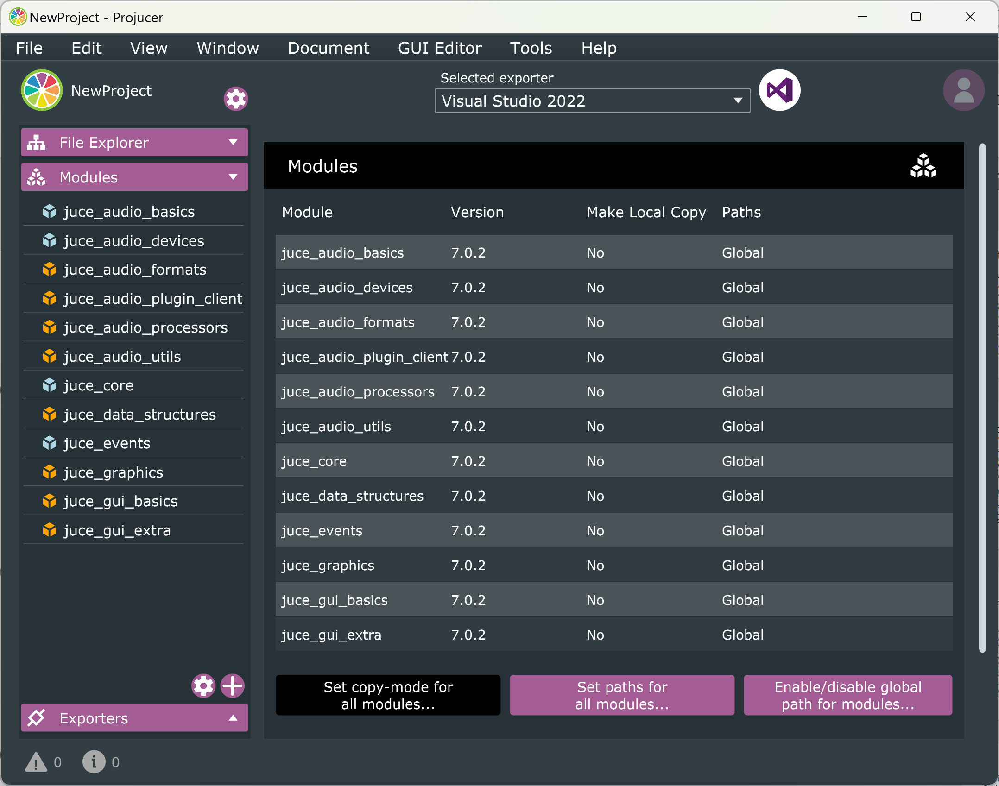
Setting up the Projucer
After downloading Juce, run Projucer
Use global search paths for modules by
clicking Modules on the left
Then clicking the settings Cog Icon on bottom left
Then Enable/disable global path for modules...
1
2
3

Slide 4
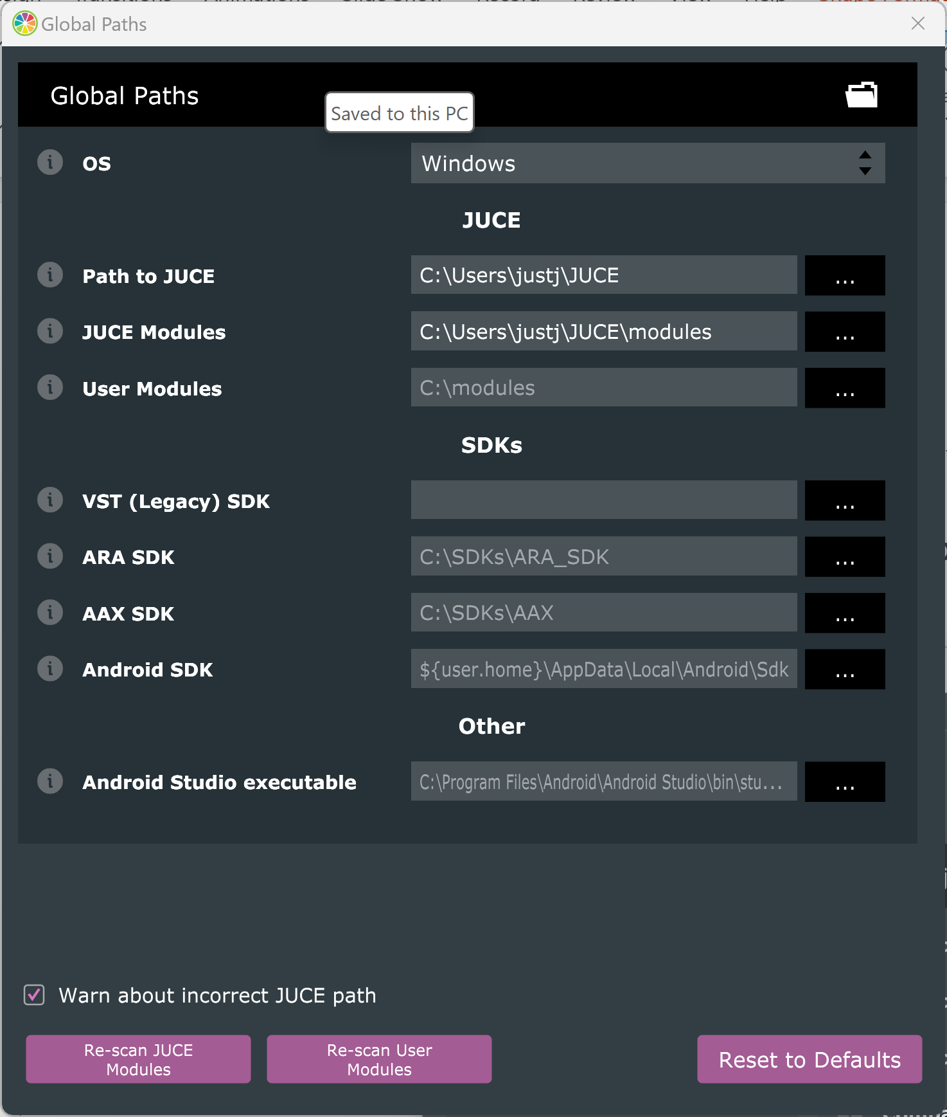
Setting up the Projucer
Global paths need to be set in Projucer app
Navigate to menu item Projucer > Global Search Paths on MacOS or File > Global Search Paths on Windows and Linux
Open global paths and set them to the right locations
I needed to reset global paths for JUCE and JUCE modules

Slide 5
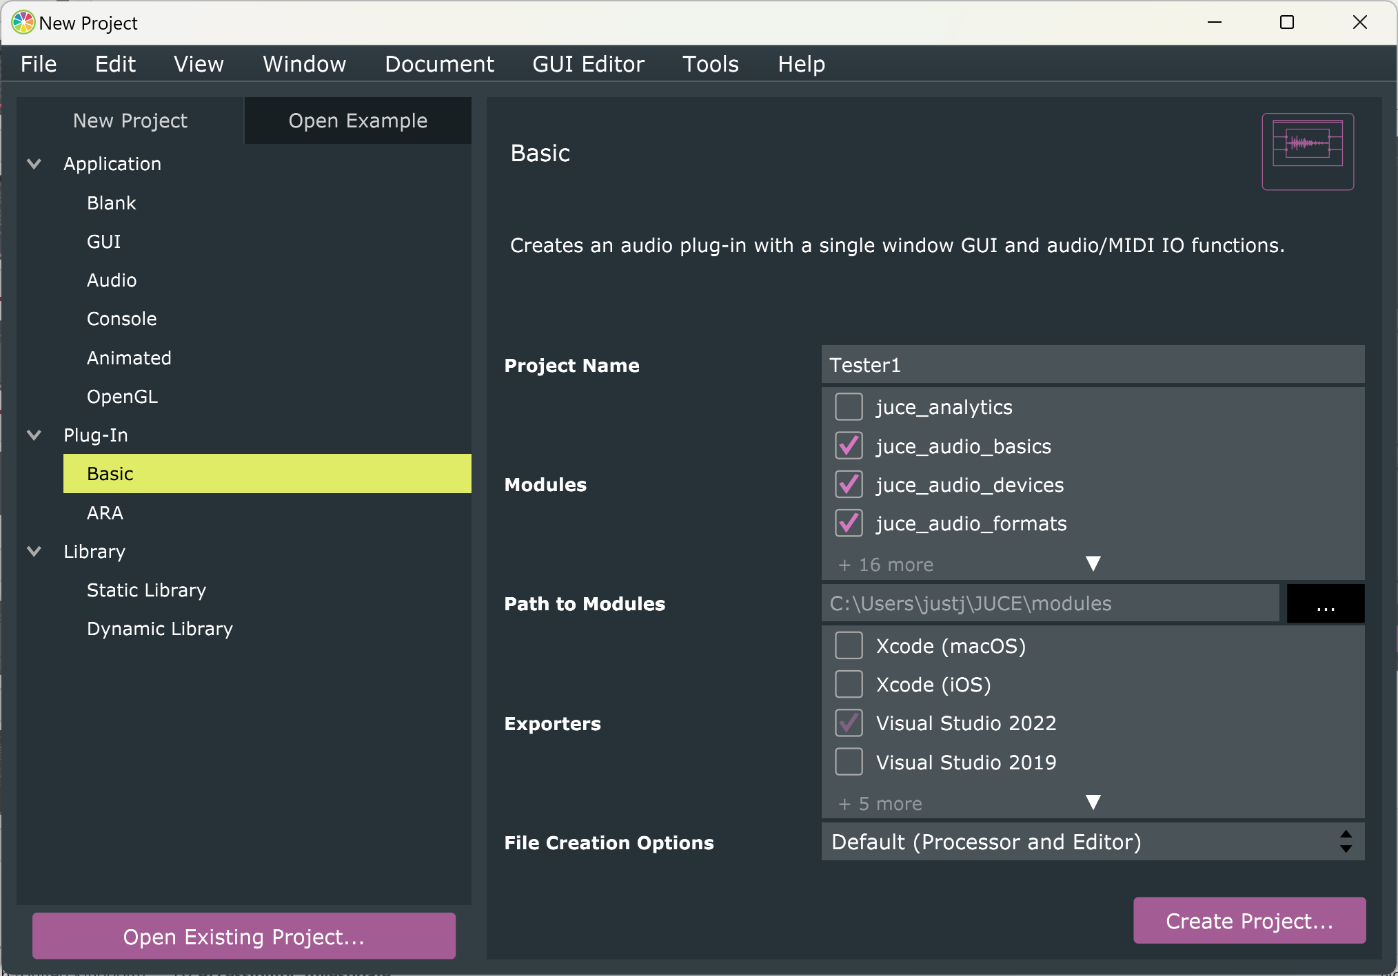
The project type
Projucer automatically generates different starter files depending on what you want to create
Select Plug-In -> Basic
We will develop a basic audio plugin
Give the project a name like ‘Tester1’ in the Project Name text field.
Make sure your development environment (Visual Studio 2022) is selected under Exporters
Click the Create Project… button

Slide 6
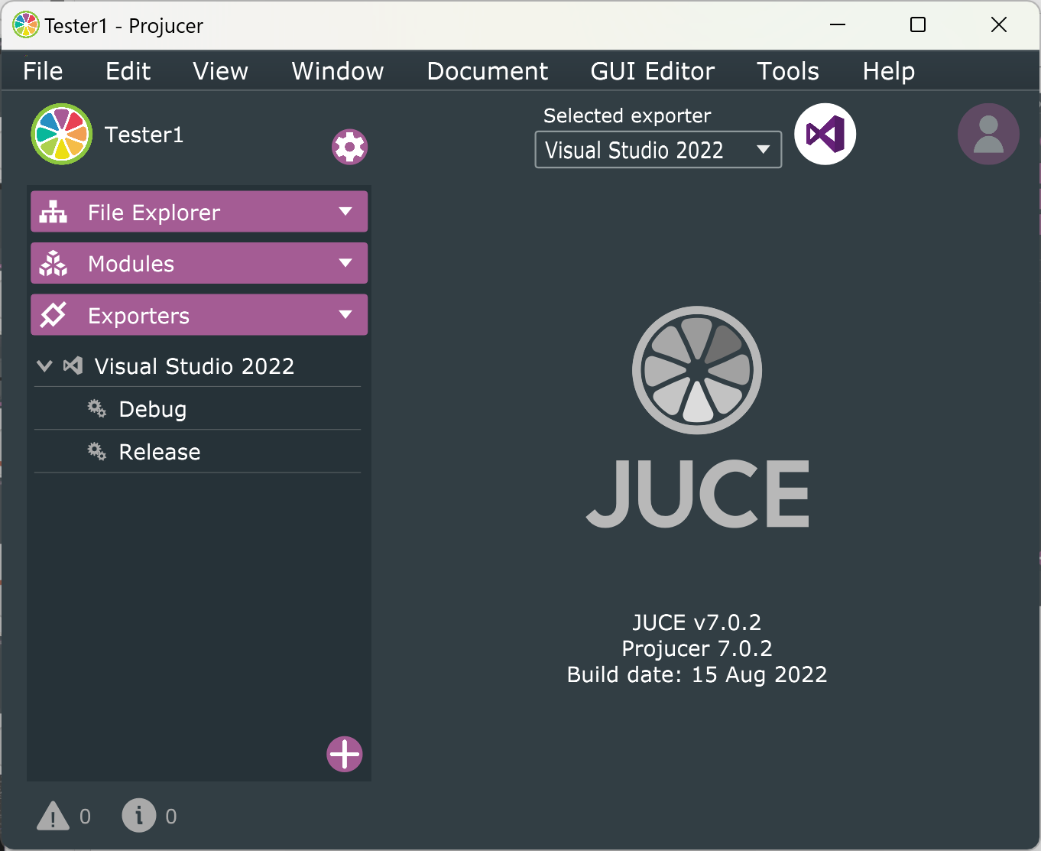
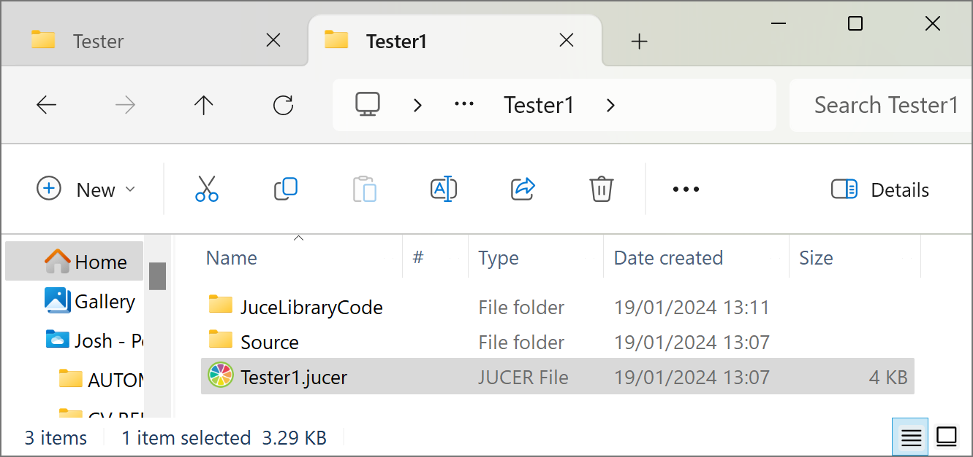
The project type
Choose a folder for your project
You should now see this ‘Tester1’ folder in the project folder
Projucer also displays a new screen now
File Explorer
Modules
Exporters

Slide 7
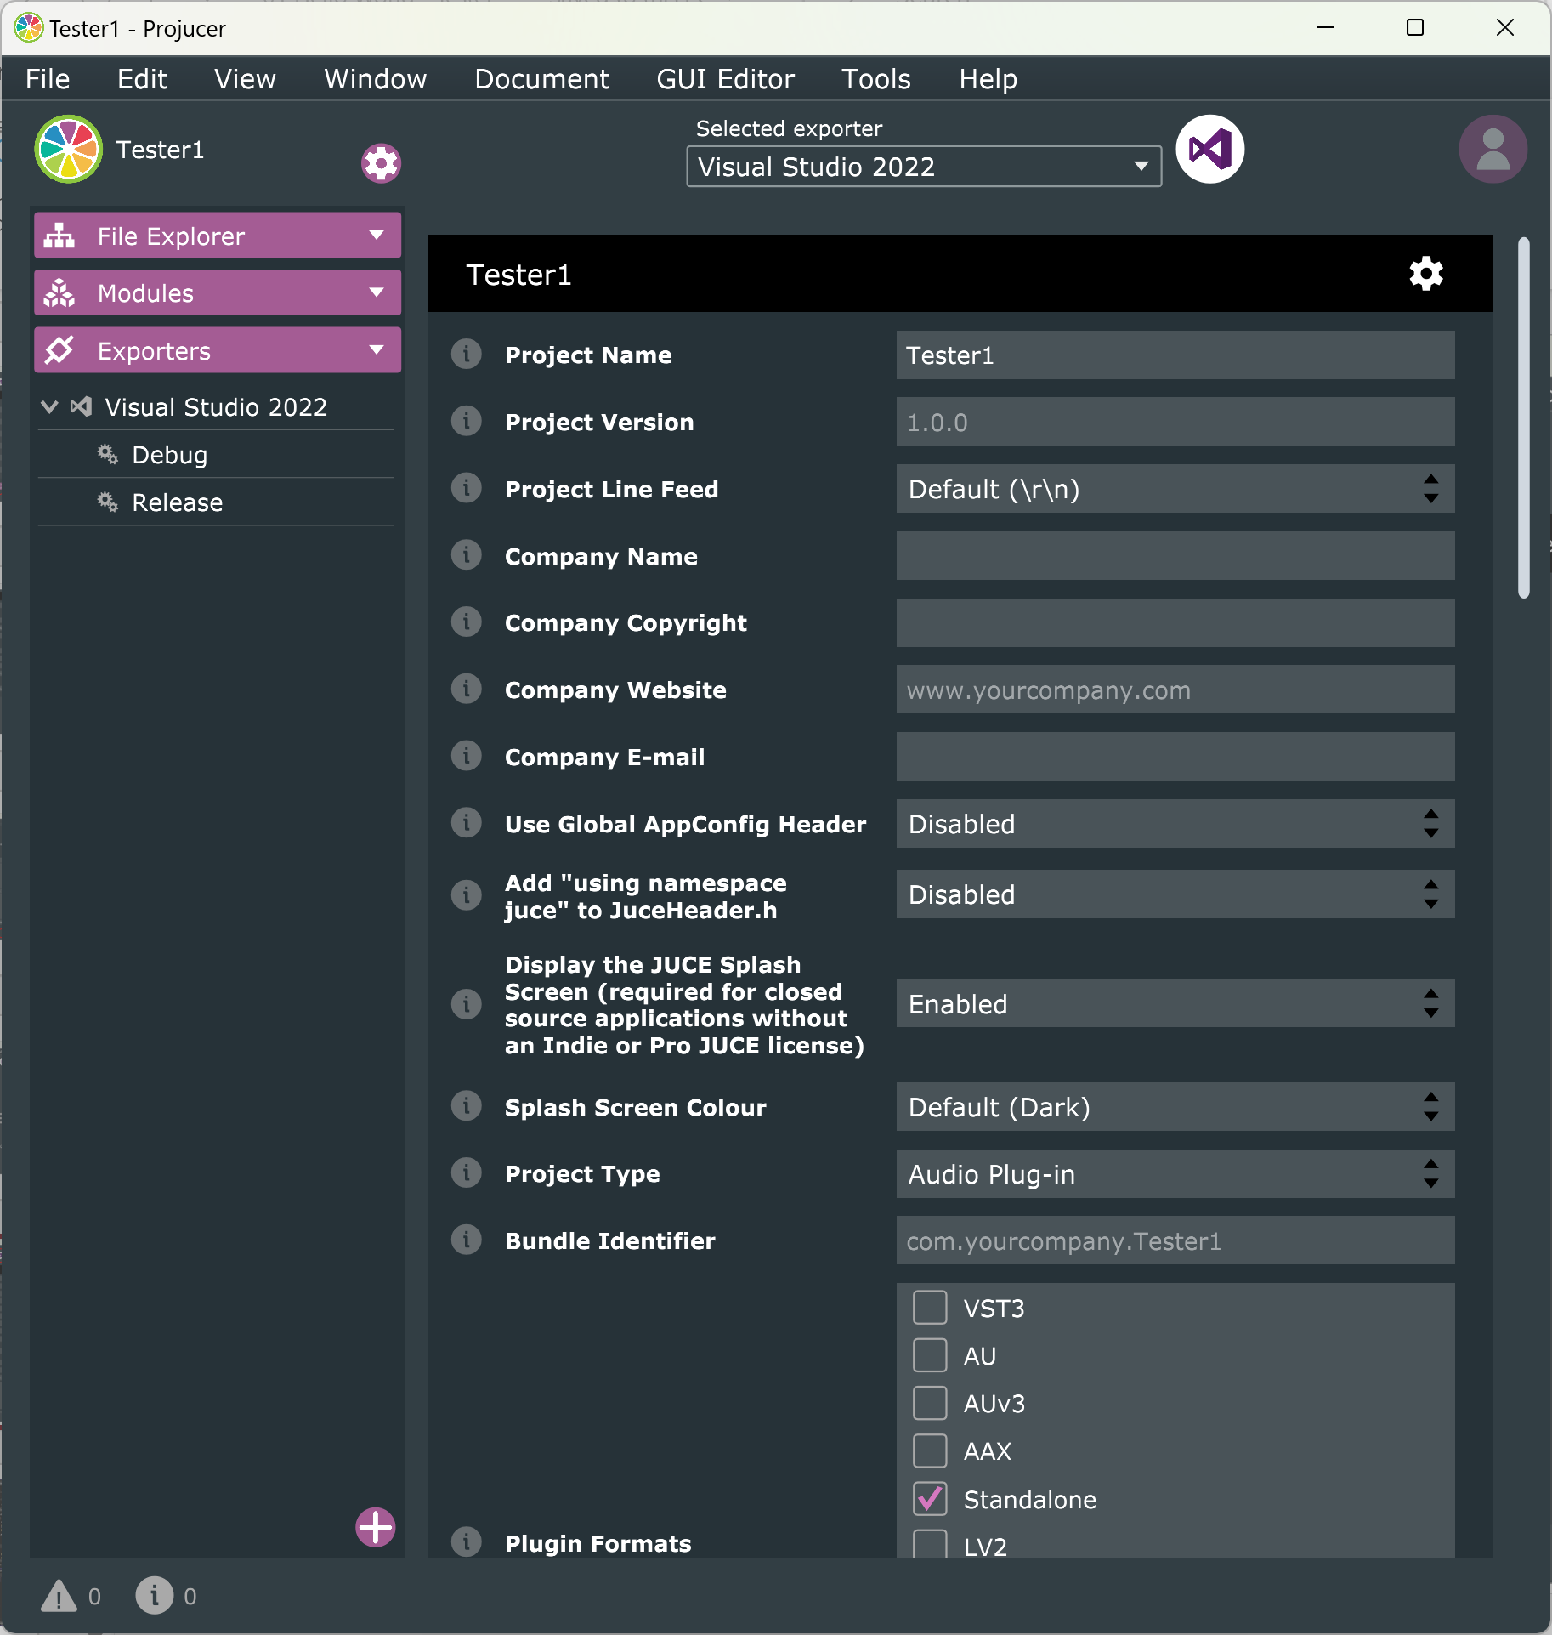
Overview
Open settings by clicking the Settings cog or selecting View -> Show Project Settings
Select Standalone as plugin format
This allows an audio plug-in to run as an application, without needing a DAW
Really useful for quick testing during development
Leave the other settings unchanged
Now click on the icon next to the exporter, to open your IDE with the right settings and files.

Slide 8
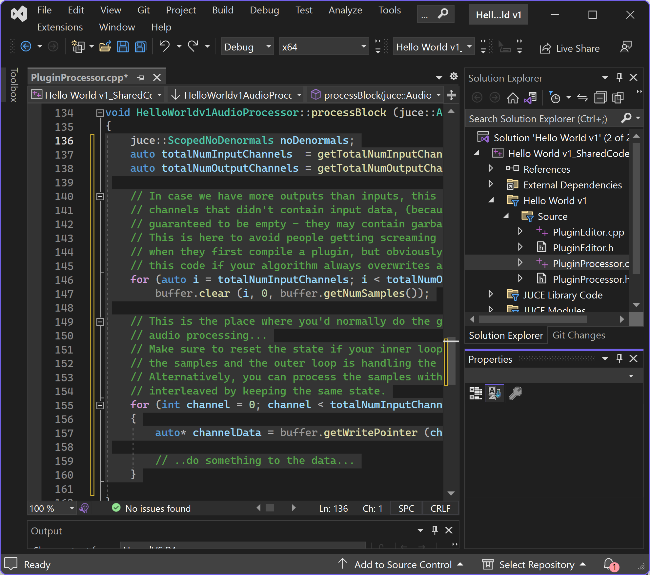
Auto-generated code
Four auto-generated files in source folder:
PluginEditor.cpp
PluginEditor.h
PluginProcessor.cpp
PluginProcessor.h
Open PluginProcessor.cpp file in your IDE
Scroll down until you reach processBlock
When JUCE auto-generated project files, a buffer array was created
This array of samples depends on block size set in your DAW
If your block size is set to 512 samples, array will have length 512
Delete all code between brackets

Slide 9
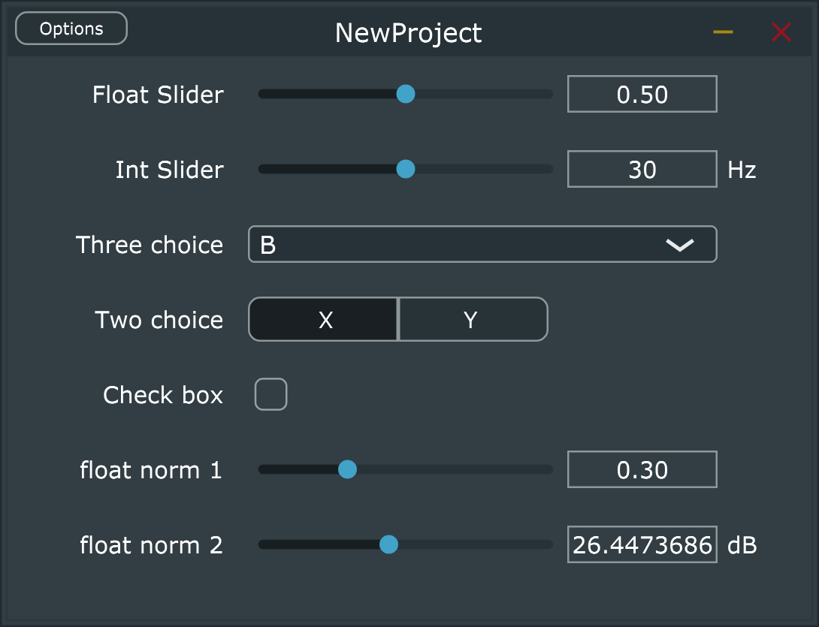
Generic Audio Processor Editor
Use generic audio processor UI for simple UI design in JUCE
Can add UI elements like sliders and boxes to a plugin
Displays AudioProcessor’s parameters as sliders, combo boxes and switches
Can show editor for a processor that doesn't supply its own custom editor
See https://docs.juce.com/master/classGenericAudioProcessorEditor.html

Slide 10
Modifying the code
In pluginProcessor.cpp, in the createEditor method, replace
return new Tester1AudioProcessorEditor (*this);
With
return new juce::GenericAudioProcessorEditor(this);
So plugin will use generic user interface provided with JUCE library
Open PluginProcessor.h file, find the private section and add a variable;
juce::AudioParameterFloat* gainParam;
Now add a slider in the constructor in pluginProcessor.cpp to change this variable.
addParameter(gainParam = new juce::AudioParameterFloat("gain", "Gain", 0.0f, 1.0f, 0.0f));
gainParam references the AudioParameterFloat we created in PluginProcessor.h.
gain is the slider’s ID
Gain will be shown next to the slider in the DAW.
Float values set minimum, maximum, and default values for the slider

Slide 11
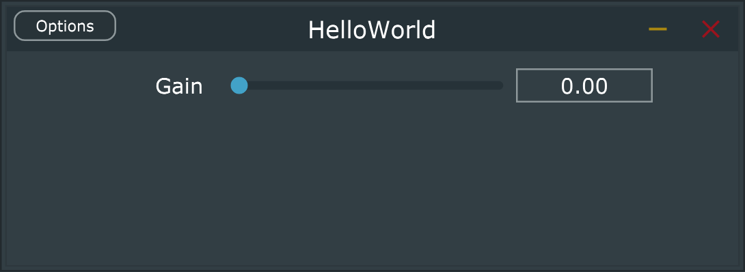
Applying gain
We now have a slider on the interface ☺
But it doesn[t do anything
Modify code in processBlock to be
float gainValue = gainParam->get();
for (int sample = 0; sample < buffer.getNumSamples(); sample)
{
for (int channel = 0; channel < getTotalNumOutputChannels(); ++channel)
{
auto* channelData = buffer.getWritePointer(channel);
channelData[sample] = 2.0 * gainValue * ((double)rand() / (RAND_MAX)) - 1.0;
}
}
Build and run it again
Now have user control ☺ ☺

Slide 12
Now edit code for more test signals
Set Gain
Noise source
Sinusoids
Set frequency
Update phase each sample
Click track (pulse wave)
Set LFO frequency
Update LFO phase each cycle
Set stereo channel
Left
Right
Centre (both channels)
Pulse wave
50 ms (0.05 sec) bursts of sinusoid
Followed by silence
LFO determines how often the bursts repeat

Slide 13
See Generic UI project for more on coding a generic interface
Creates different looking UI objects for different parameters
…
addParameter(intParam = new juce::AudioParameterInt
("INTPARAM", "Int Slider", 20, 40, 30, "Hz"));
addParameter(choice3Param = new juce::AudioParameterChoice
("THREECHOICE", "Three choice", { “Noise", “Sinusoid", “Pulses"}, 1));
addParameter(floatParam = new juce::AudioParameterFloat
("FLOATPARAM", “Frequency", 0.0f, 1.0f, 0.5 f));
addParameter(floatParam = new juce::AudioParameterFloat
("FLOATPARAM", “LFO frequency", 0.0f, 1.0f, 0.5 f));
…

Slide 14
Define parameters and variables
In private section of PluginProcessor.h, add more parameters and variables
juce::AudioParameterChoice* testSignalParam;
juce::AudioParameterFloat* frequencyParam;
juce::AudioParameterFloat* lfoFrequencyParam;
juce::AudioParameterChoice* channelParam;
float inputPhase = 0.0;
float lfoPhase = 0.0;
float frequencyValue = 1000.0f;
float lfoFrequencyValue = 1.0f;
int testSignal = 0;
int channelValue = 1;

Slide 15
Add parameters to UI
Add parameters in constructor in pluginProcessor.cpp
addParameter(testSignalParam = new juce::AudioParameterChoice
("testSignal", "Test Signal", { "Noise", "Sinusoid", "Pulse wave"}, 0));
addParameter(gainParam = new juce::AudioParameterFloat
("gain", "Gain", 0.0f, 1.0f, 0.0f));
addParameter(frequencyParam = new juce::AudioParameterFloat
("frequency", "Frequency", 20.0f, 2000.0f, 1000.0f));
addParameter(lfoFrequencyParam = new juce::AudioParameterFloat
("lfoFrequency", "LFO frequency", 0.2f, 5.0f, 1.0f));
addParameter(channelParam = new juce::AudioParameterChoice
("channel", "Channel", { "Left", "Centre", "Right" }, 1));

Slide 16
Update parameters and phases in processBlock
Add parameters in constructor in pluginProcessor.cpp
testSignal = testSignalParam->getIndex();
frequencyValue = frequencyParam->get();
lfoFrequencyValue = lfoFrequencyParam->get();
channelValue = channelParam->getIndex();
Update phases
for (int sample = 0; sample < buffer.getNumSamples(); sample++)
{
inputPhase += frequencyValue / getSampleRate();
while (inputPhase >= 1.0) inputPhase -= 1.0;
lfoPhase += lfoFrequencyValue / getSampleRate();
while (lfoPhase >= 1.0) lfoPhase -= 1.0;
…
}

Slide 17
Generate test signal in processBlock
for (int sample = 0; sample < buffer.getNumSamples(); sample++) {
…
for (int channel = 0; channel < getTotalNumOutputChannels(); ++channel) {
auto* channelData = buffer.getWritePointer(channel);
if (testSignal == 0)
channelData[sample] = 2.0 * gainValue * ((double)rand() / RAND_MAX) - 1.0;
else if (testSignal == 1)
channelData[sample] = gainValue * sinf(juce::MathConstants<float>::twoPi * inputPhase);
else if (testSignal == 2) {
if (lfoPhase > 0.05 * lfoFrequencyValue) channelData[sample] = 0;
else
channelData[sample]= gainValue * sinf(juce::MathConstants<float>::twoPi * inputPhase);
}
else channelData[sample] = 0;
}
…
}

Slide 18
Select channel in processBlock
for (int sample = 0; sample < buffer.getNumSamples(); sample++) {
…
for (int channel = 0; channel < getTotalNumOutputChannels(); ++channel) {
}
if (channelValue == 0) buffer.getWritePointer(1)[sample] = 0;
if (channelValue == 2) buffer.getWritePointer(0)[sample] = 0;
}
…
}

Slide 19
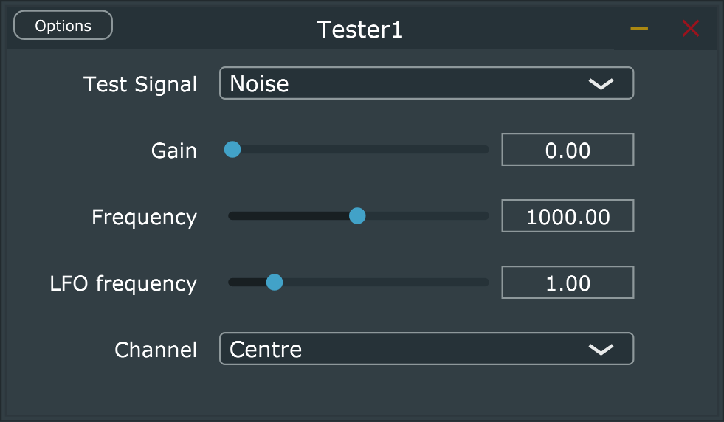
Build and run
Should now have a stand-alone plug-in that can generate simple test signals

Slide 20

Make this a VST plug-in
Go back to the projucer.
If not already open, open settings by clicking Settings Icon or selecting View -> Show Project Settings
Select VST3 as plugin format
Select File→ Save Project
Go back to your IDE (Visual Studio), reload the project settings and rebuild the project
We can now use this plugin in a DAW
Use it to test other audio effect plug-ins
Tester will generate a test signal, which then gets sent to the plug-in under test

Slide 21
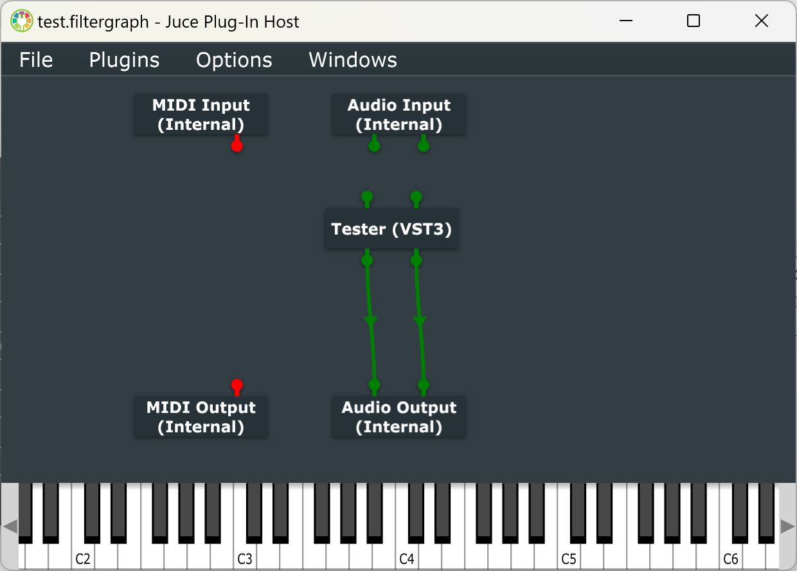
Further work
Try this out in a DAW
Here it is in JUCE’s plug-in host
Use this so that the Tester’s output is the audio input to another audio effect
See which test signals are good to use with different audio effects. For instance
A pulse wave is good for testing reverb or delay
A noise source is good for testing filters and equalisers
Sinusoids are good for testing pitch shifting

